Slide 1
Computational analysis of microbiome data obtained from parasites
Martha Zakrzewski
QIMR Berghofer Medical Research Institute
Brisbane

Slide 2
https://github.com/marthazak/CiP

Slide 3
Microbes and parasites
Microbes (archaea, bacteria, fungi, protozoans, and viruses) play varied roles in host health
Parasites have been documented to disrupt their host microbiome (Dheilly et al, 2015) - Parasite Microbiome Project
host
parasite
microbiome
Notes:
Usually parasite was studies as one single organisis. Parasite involved in interaction with the host but also its microbime.

Slide 4
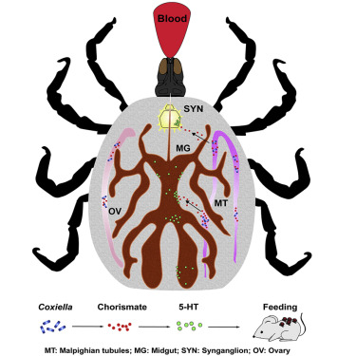
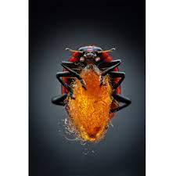
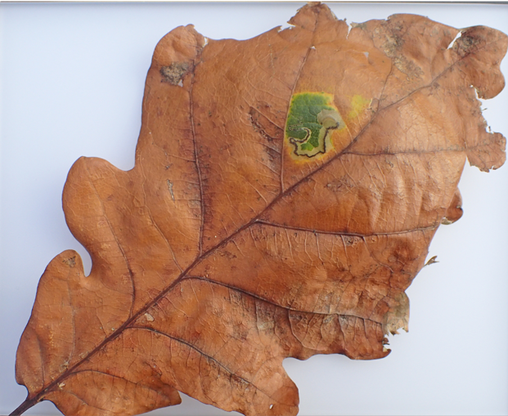
Microbes and parasites
Roles of parasite-associated microbes in host diseases
Enhanced nutritional environment (plant green-islands induced by moths / Wolbachia)
Nutritional production (Coxiella like endosymbiont/ tick)
Behavioral manipulation (wasp-associated virus on beetle)
Increased inflammatory responses
Notes:
Salmonella may reside in the tegument and intestinal tracts of all Schistosoma species causing typhoid fever and schistosomiasis
Coxiella-like endosymbiont provides ticks B vitamins missing from blood meals, enabling ticks to specialize in hematophagy
tiny parasitic wasp injects a virus into ladybugs that turns them into zombie bodyguards
Loss of Wolbachia in filarial nematodes leads to loss of worm viability and fertility in human trials and increase antifilarial treatment efficacy

Slide 5
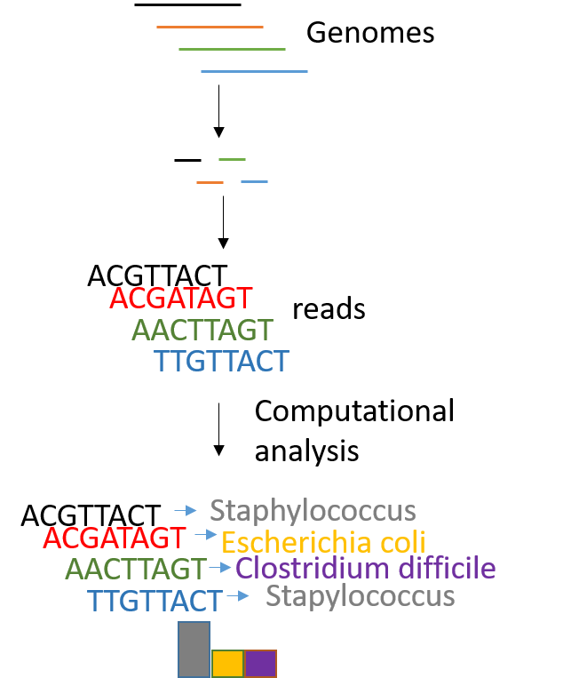
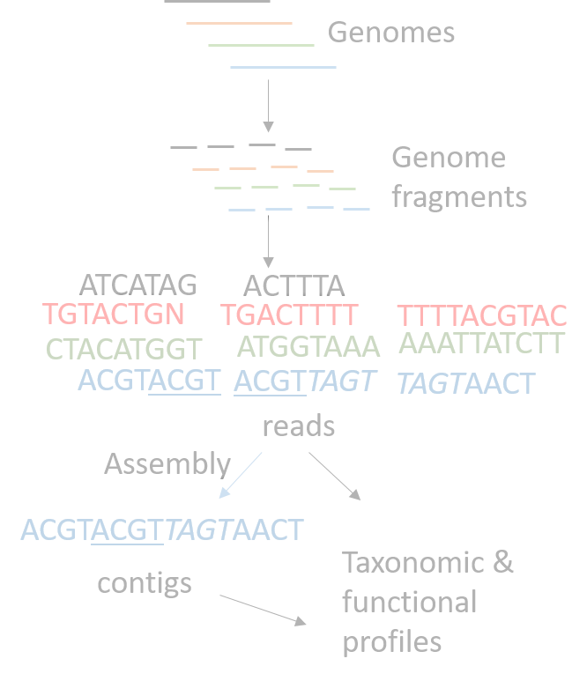
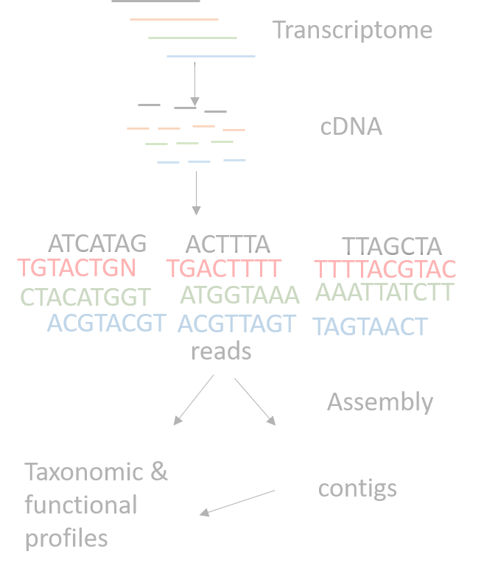
Approaches to study microbiota
Gene-targeted approach
Whole genome shotgun strategy
RNA sequencing
PCR amplified gene

Slide 6
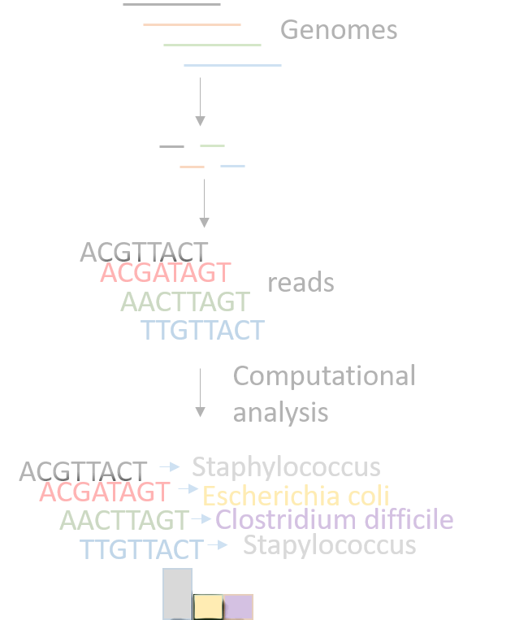
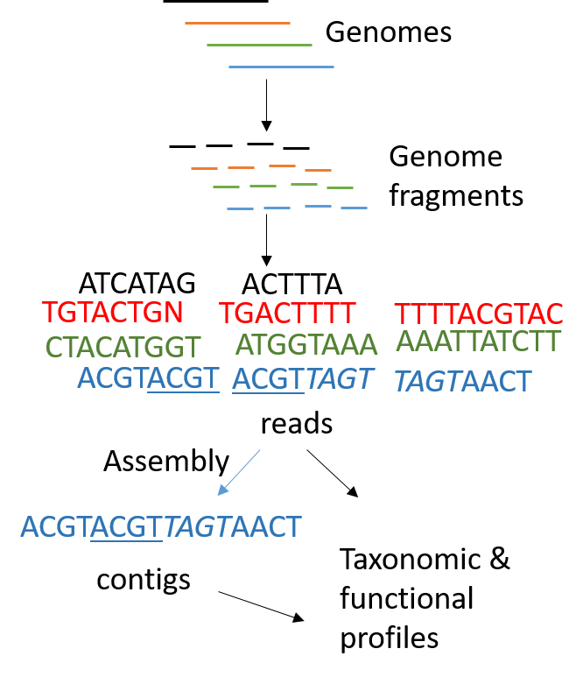
Approaches to study microbiota
Gene-targeted approach
Whole genome shotgun strategy

Slide 7
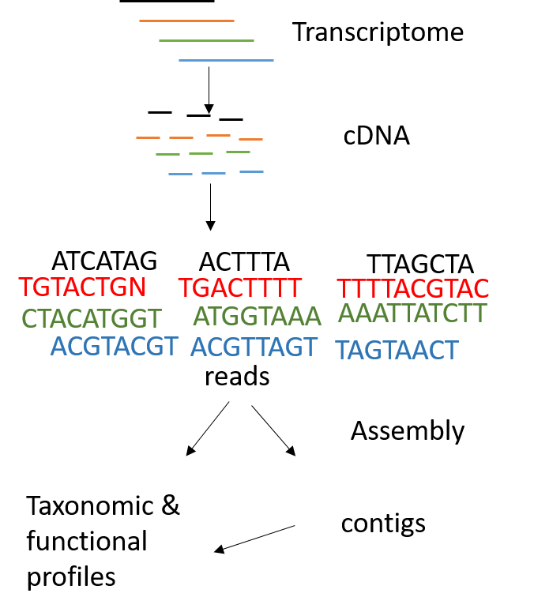
Approaches to study microbiota
Gene-targeted approach
Whole genome shotgun strategy
RNA sequencing

Slide 8
Summary
 | Gene-targeted approach | Metagenome | Meta-transcriptome
Results | Taxonomic characterization of organisms | Taxonomic and functional profiling of genomes and genes | Taxonomic and functional profiling of transcriptional active organisms
Assignment rate | Most of the reads are assigned | High number of unassigned reads | High number of unassigned reads
Disadvantage | PCR bias | Sequencing of host | Sequencing of host and ribosomal genes

Slide 9
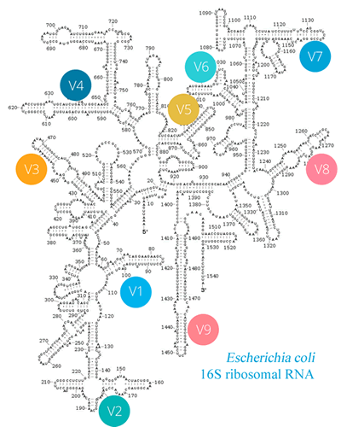
Gene-targeted approach
PCR amplified gene

Slide 10
Analysis pipeline
Sequence quality control
Taxonomic classification
Data
Mining
Vis
Clustering

Slide 11
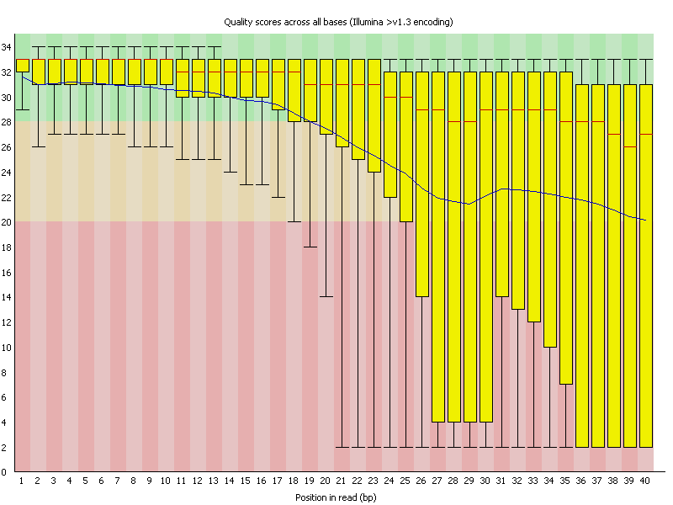
Analysis pipeline
Sequence quality control
Taxonomic classification
Data
Mining
Vis
Clustering
Sequence of low quality have to be removed

Slide 12
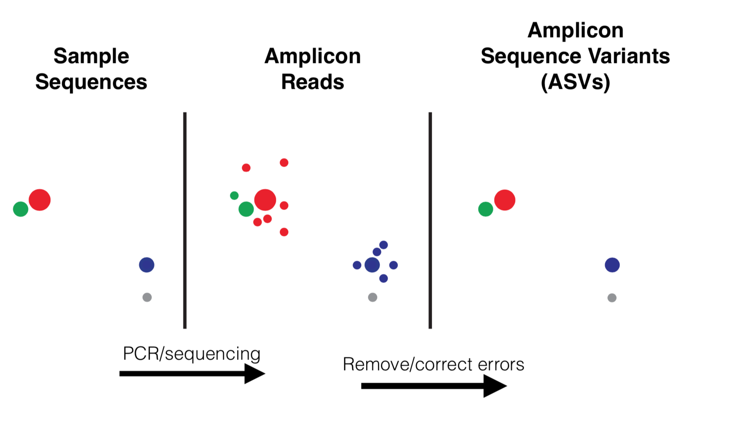
Analysis pipeline
Sequence quality control
Taxonomic classification
Data
Mining
Vis
Clustering

Slide 13
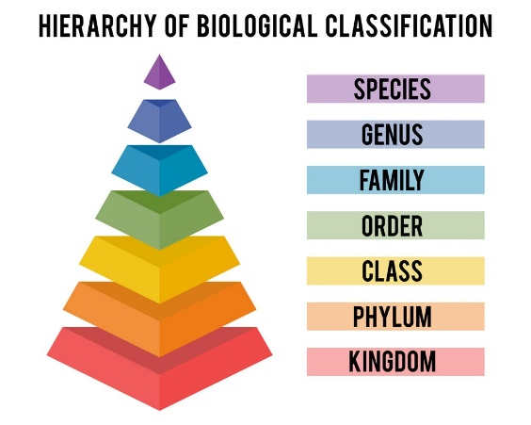
Analysis pipeline
Sequence quality control
Clustering
(OTU)
Taxonomic classification
Data
Mining
Vis
16S DNAs assigned to taxonomy based on comparison to 16S DNAs of known
origin based on databases (using taxonomic classifier and BLAST)
16S DNA
sequences
ACTGACGATA
Bacteria, Proteobacteria, …, E. coli
Bacteria, Bacteroidetes, …, B. vulgatus
Bacteria, Firmicutes, …, C. difficiles
Bacteria, Proteobacteria, …, E. coli
Archaea, Euryarchaeota , …, M. marisnigri
Bacteria, Firmicutes, …, C. difficiles
Bacteria, Proteobacteria, …, E. coli
Archaea, Euryarchaeota, …, M. marisnigri
TGATGGATCTA
CATCTACGGC
TTGCATTGATC
CTGATCTACG
ACTGACGATA
TTGCATTGATC
GAGTACTGATA

Slide 14

Analysis pipeline
Sequence quality control
Taxonomic classification
Clustering
(OTU)
Data
Mining
Vis

Slide 15

Analysis pipeline
Sequence quality control
Taxonomic classification
Data
Mining
Vis
Clustering
Quality control
ASV formation
Taxonomic classification:

Slide 16
Why R
It’s free
Active development
Reproducible analysis
R can handle large datasets
Collaborative
Low risk of inadvertent data loss

Slide 17
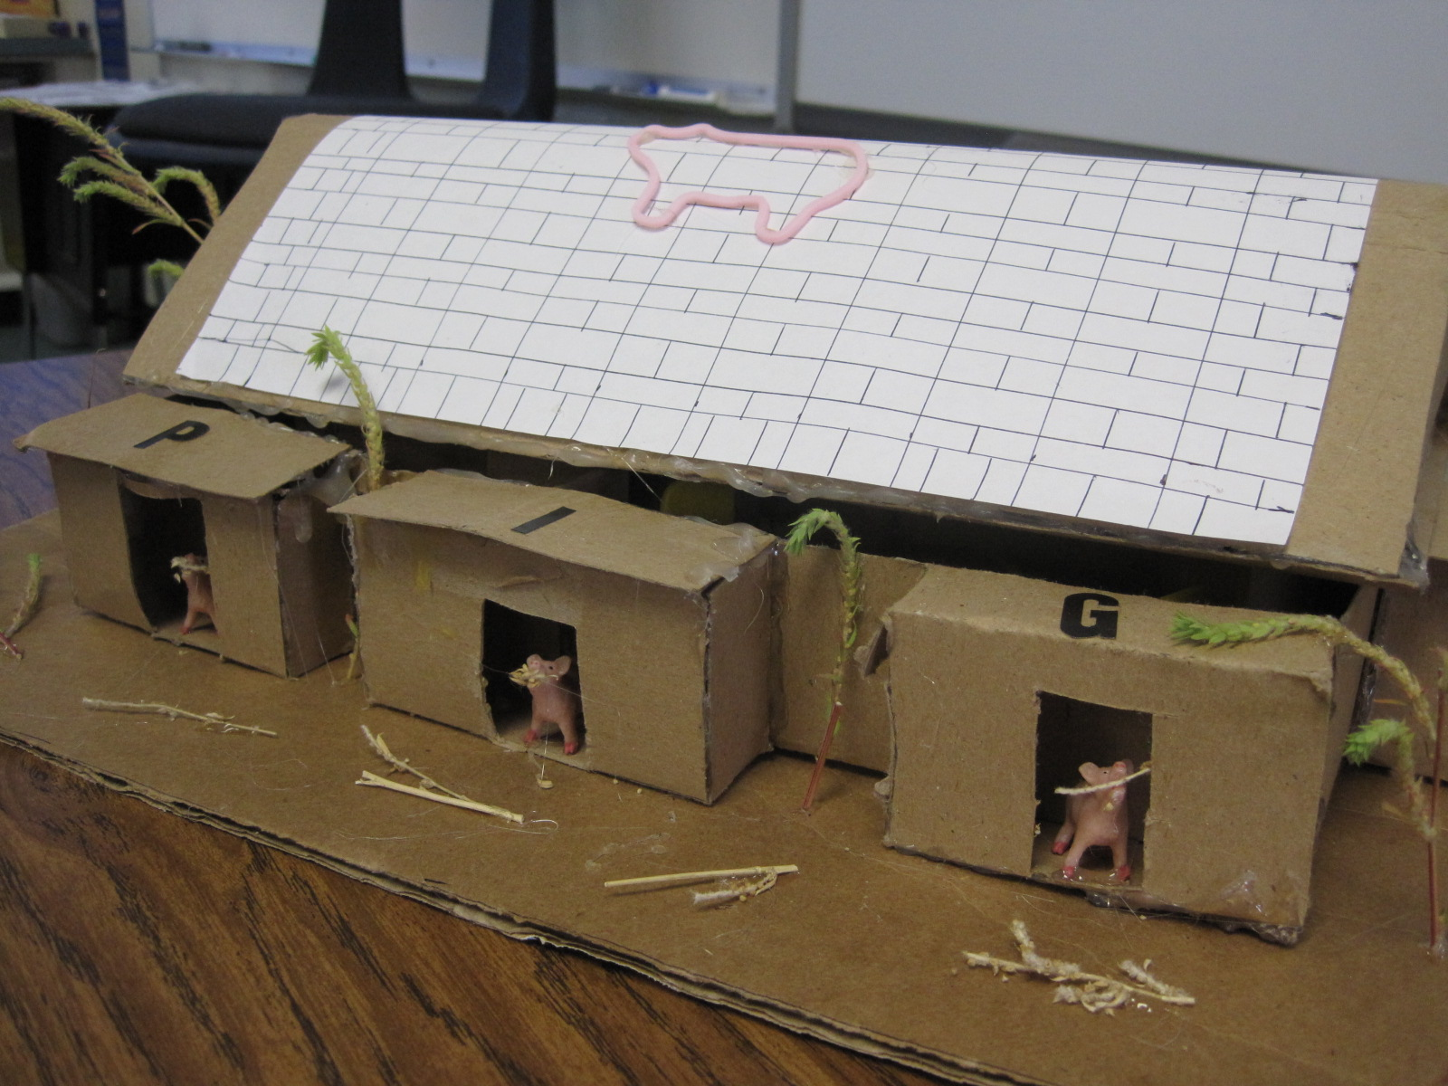
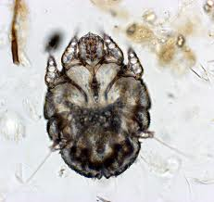

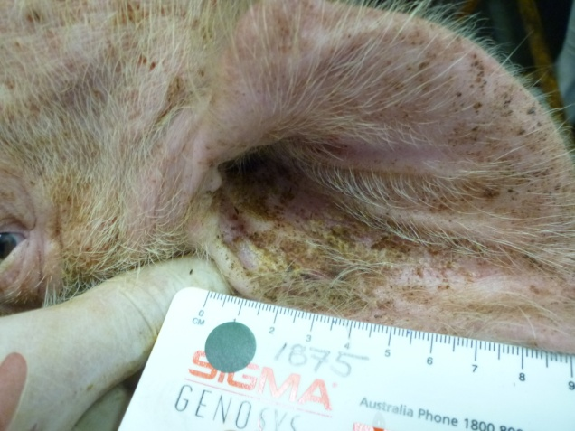
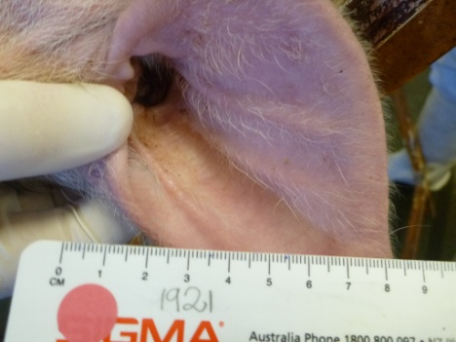
Affect of scabies infection on skin microbiome - Method
Pig model as a basis for human skin microbiota of patients infected with scabies mites
Three groups
C: control
M: mites, no dexamethosone
MD: mites, dexamethosone
C
M
MD
Week 0
Week 7
Week 10
Week 21
Before scabies infestation
Mild
infestation
Severe
infestation
Healed
skin

Slide 18
Input data
Data matrix file
Data taxonomy
Metadata file

Slide 19
Input data
Data matrix file
Represents the frequency of each taxon in each sample.
Recommendation: non-normalized (raw) filtered read count

Slide 20
Input data
Data matrix file
OTU | Header | PS12 | PS13 | PS11 | PS19 | PS16 | PS34 | PS35 | PS82 | PS20 | PS15 | PS30
OTU | Bacteroidetes 0 | 1 | 0 | 0 | 0 | 0 | 0 | 0 | 0 | 0 | 0 | 0
OTU | Firmicutes; Streptococcus 1 | 25 | 142 | 102 | 10 | 4 | 14 | 37 | 2 | 6 | 1 | 3
OTU | Firmicutes; Oscillibacter 2 | 0 | 0 | 0 | 0 | 0 | 3 | 0 | 0 | 0 | 0 | 0
Phylum | Header | PS68 | PS91 | PS69 | 2310 | PS70 | PS39 | PS41 | PS93 | PS54 | PS20 | PS47 | PS23 | PS17
Phylum | Proteobacteria | 181 | 370 | 143 | 2763 | 2958 | 2827 | 1064 | 5377 | 1152 | 2722 | 48 | 2159 | 443
Phylum | Bacteroidetes | 117 | 139 | 509 | 102 | 1189 | 866 | 979 | 147 | 1458 | 2478 | 25 | 767 | 534
Phylum | Actinobacteria | 1126 | 22875 | 854 | 15667 | 6990 | 1958 | 2751 | 4709 | 6716 | 12064 | 12588 | 1095 | 213
Class | Header | PS68 | PS91 | PS69 | 2310 | PS70 | PS39 | PS41 | PS93 | PS54 | PS20 | PS47 | PS23 | PS17
Class | Alphaproteobacteria | 14 | 34 | 10 | 16 | 111 | 242 | 89 | 11 | 508 | 98 | 12 | 82 | 28
Class | Flavobacteria | 33 | 43 | 20 | 43 | 332 | 641 | 530 | 29 | 1216 | 663 | 17 | 172 | 40
Class | Bacilli | 3210 | 3577 | 4368 | 2099 | 38343 | 2158 | 5350 | 1052 | 7291 | 26505 | 2743 | 4158 | 3357
Order | Header | PS68 | PS91 | PS69 | 2310 | PS70 | PS39 | PS41 | PS93 | PS54 | PS20 | PS47 | PS23 | PS17
Order | Erysipelotrichales | 38 | 24 | 77 | 10 | 327 | 55 | 138 | 71 | 115 | 405 | 8 | 90 | 115
Order | Lactobacillales | 1276 | 402 | 4297 | 1101 | 36539 | 1929 | 4833 | 701 | 6754 | 25947 | 1248 | 4004 | 3262
Order | Actinomycetales | 1105 | 22860 | 778 | 15663 | 6927 | 1940 | 2612 | 4691 | 6553 | 12024 | 12577 | 1076 | 192
Family | Header | PS68 | PS91 | PS69 | 2310 | PS70 | PS39 | PS41 | PS93 | PS54 | PS20 | PS47 | PS23 | PS17
Family | Lactobacillaceae | 246 | 81 | 2473 | 355 | 9498 | 119 | 263 | 253 | 213 | 9409 | 187 | 886 | 1777
Family | Corynebacteriaceae | 304 | 20217 | 204 | 15077 | 2521 | 690 | 598 | 4008 | 1869 | 9982 | 11202 | 305 | 87
Family | Enterobacteriaceae | 22 | 75 | 17 | 2655 | 374 | 1645 | 55 | 50 | 11 | 212 | 0 | 25 | 34
Genus | Header | PS68 | PS91 | PS69 | 2310 | PS70 | PS39 | PS41 | PS93 | PS54 | PS20 | PS47 | PS23 | PS17
Genus | Streptococcus | 860 | 252 | 1649 | 577 | 25660 | 1503 | 4227 | 383 | 5859 | 4290 | 697 | 2217 | 565
Genus | Corynebacterium | 300 | 20174 | 200 | 15064 | 2509 | 685 | 589 | 4000 | 1851 | 9945 | 11181 | 296 | 87
Genus | Staphylococcus | 1907 | 3151 | 26 | 939 | 1566 | 9 | 28 | 332 | 46 | 67 | 1456 | 29 | 17

Slide 21
Input data - metadata
Meta information for each sample
Multiple optional explanatory variables (also called environmental variables)
variables manipulated by the experimenter (e.g. infected/uninfected), confounding factors (e.g. age, gender, BMI),
discrete (e.g. case/control, female/male, geography): non-numeric values
numeric (e.g. age, days after treatment, BMI, blood glucose level)
Missing values should be encoded as "NA". (not 0)

Slide 22
Input data -Metadata-
sampleid | label | Pair | Group1 | Group2 | Include | Infection | Timepoint
PS15 | M1.1 | 1505 | M.tp1 | TP-1 week0 | 1 | SyDn | TP-1
PS11 | M2.1 | 1876 | M.tp1 | TP-1 week0 | 1 | SyDn | TP-1
PS14 | M3.1 | 1883 | M.tp1 | TP-1 week0 | 1 | SyDn | TP-1
PS16 | MD1.1 | 1875 | MD.tp1 | TP-1 week0 | 0 | SyDy | TP-1
PS19 | MD2.1 | 1885 | MD.tp1 | TP-1 week0 | 0 | SyDy | TP-1
PS17 | MD3.1 | 1909 | MD.tp1 | TP-1 week0 | 0 | SyDy | TP-1
PS22 | C1.1 | 1872 | C.tp1 | TP-1 week0 | 1 | control | TP-1
PS24 | C2.1 | 1874 | C.tp1 | TP-1 week0 | 1 | control | TP-1
PS21 | C3.1 | 1882 | C.tp1 | TP-1 week0 | 1 | control | TP-1
PS31 | M1.7 | 1505 | M.tp2 | TP-2 week7 | 1 | SyDn | TP-2
PS27 | M2.7 | 1876 | M.tp2 | TP-2 week7 | 1 | SyDn | TP-2
PS30 | M3.7 | 1883 | M.tp2 | TP-2 week7 | 1 | SyDn | TP-2
PS32 | MD1.7 | 1875 | MD.tp2 | TP-2 week7 | 0 | SyDy | TP-2
PS35 | MD2.7 | 1885 | MD.tp2 | TP-2 week7 | 0 | SyDy | TP-2
PS33 | MD3.7 | 1909 | MD.tp2 | TP-2 week7 | 0 | SyDy | TP-2
PS38 | C1.7 | 1872 | C.tp2 | TP-2 week7 | 1 | control | TP-2
PS40 | C2.7 | 1874 | C.tp2 | TP-2 week7 | 1 | control | TP-2
PS37 | C3.7 | 1882 | C.tp2 | TP-2 week7 | 1 | control | TP-2

Slide 23
https://github.com/marthazak/CiP

Slide 24
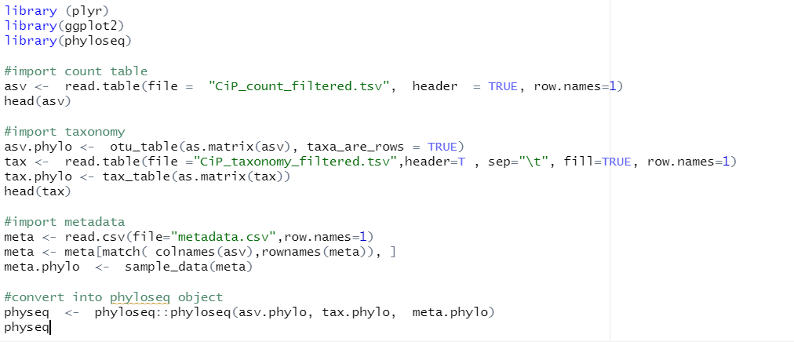
Import data

Slide 25
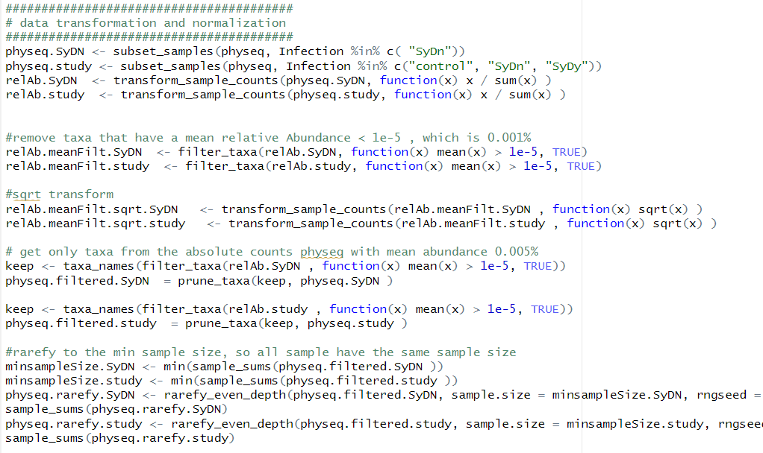
Data transformation and normalization

Slide 26
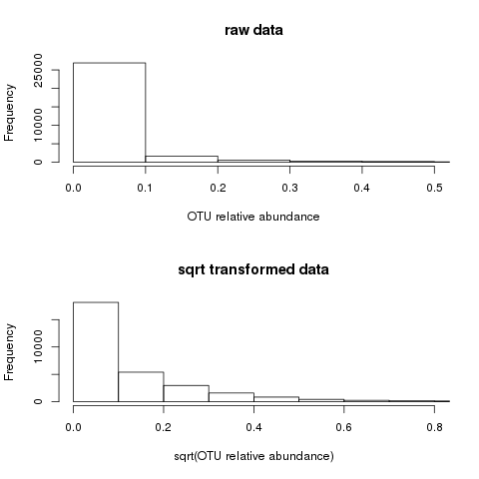
Data transformation
Square root data transformation
Spreads out low abundant values: zoom in minor abundant microbes
Compresses highly abundant microbes

Slide 27
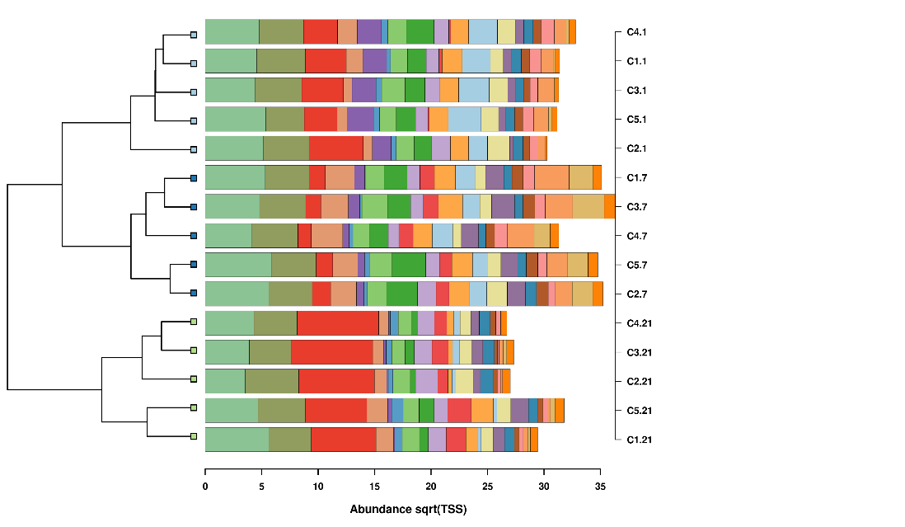
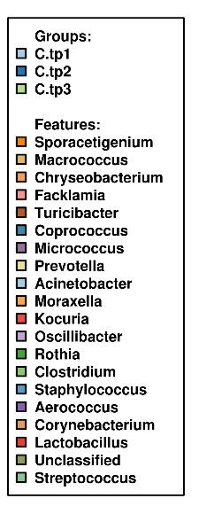
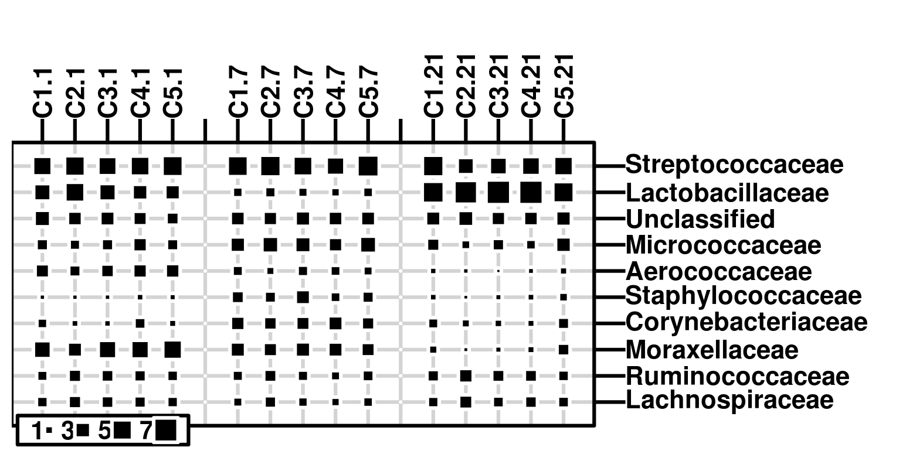
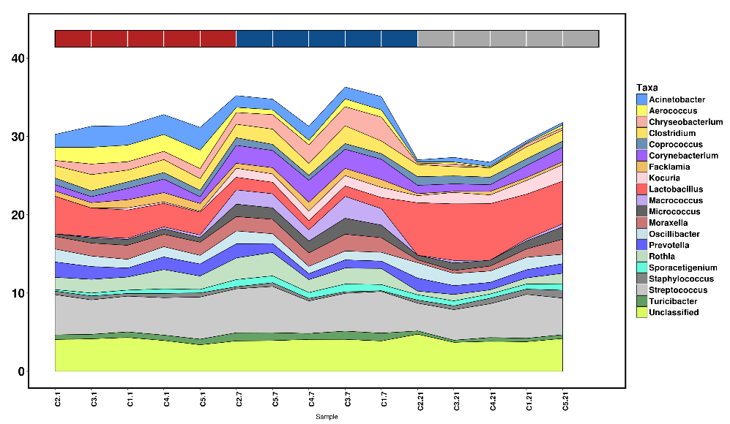
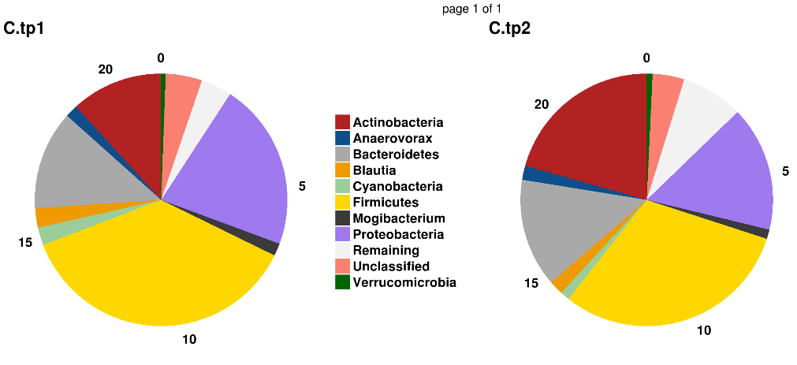
Data visualization
Clustered barchart
Bubbleplot
Areaplot
Piechart

Slide 28
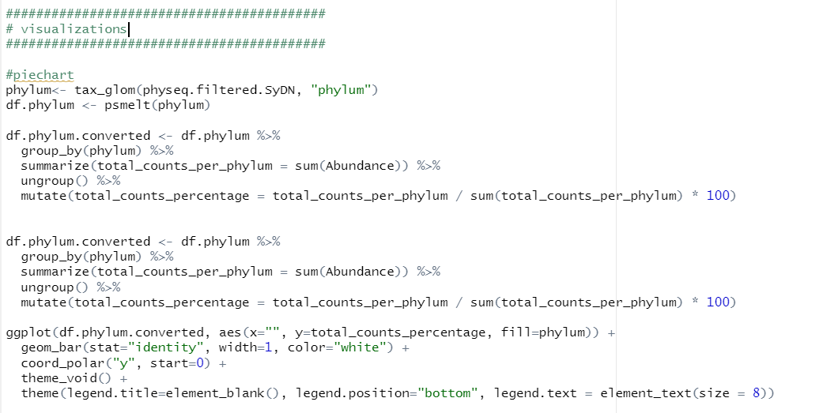
Piechart

Slide 29
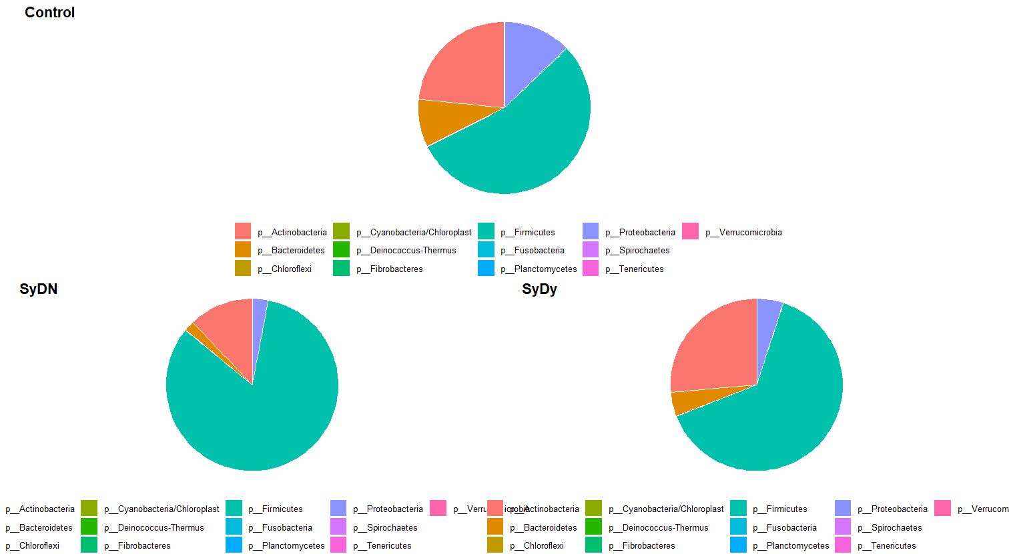
Piechart

Slide 30
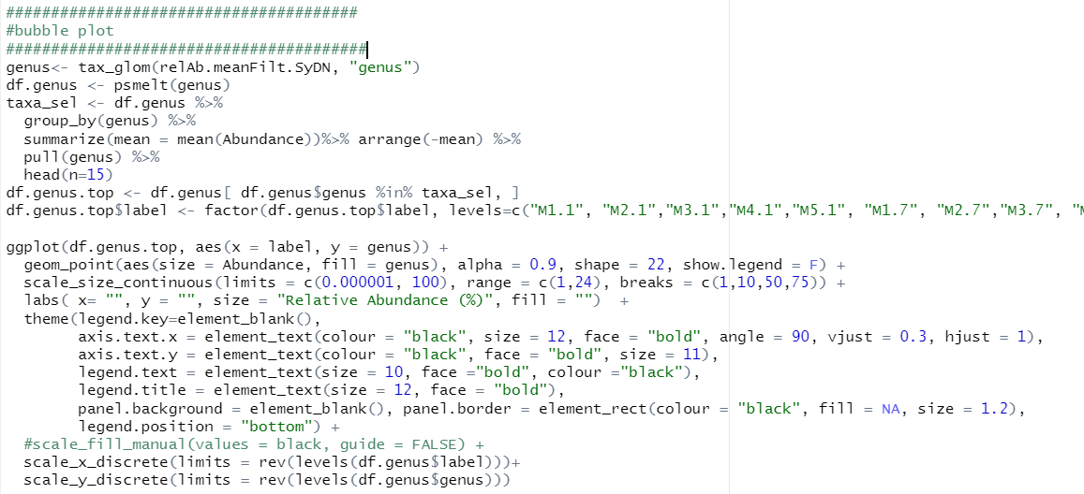
Bubble plot

Slide 31
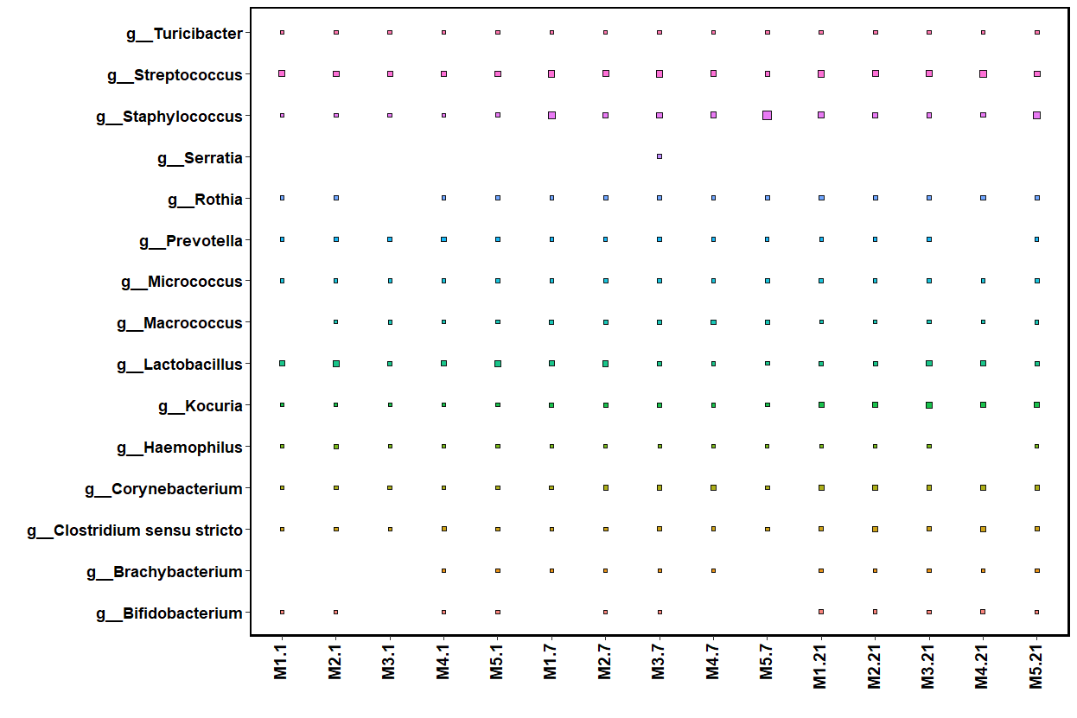
Bubble plot

Slide 32
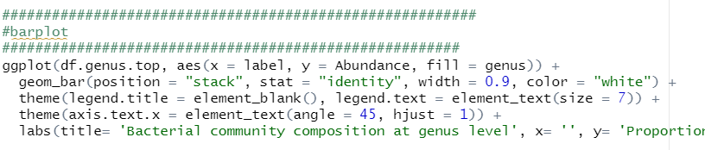
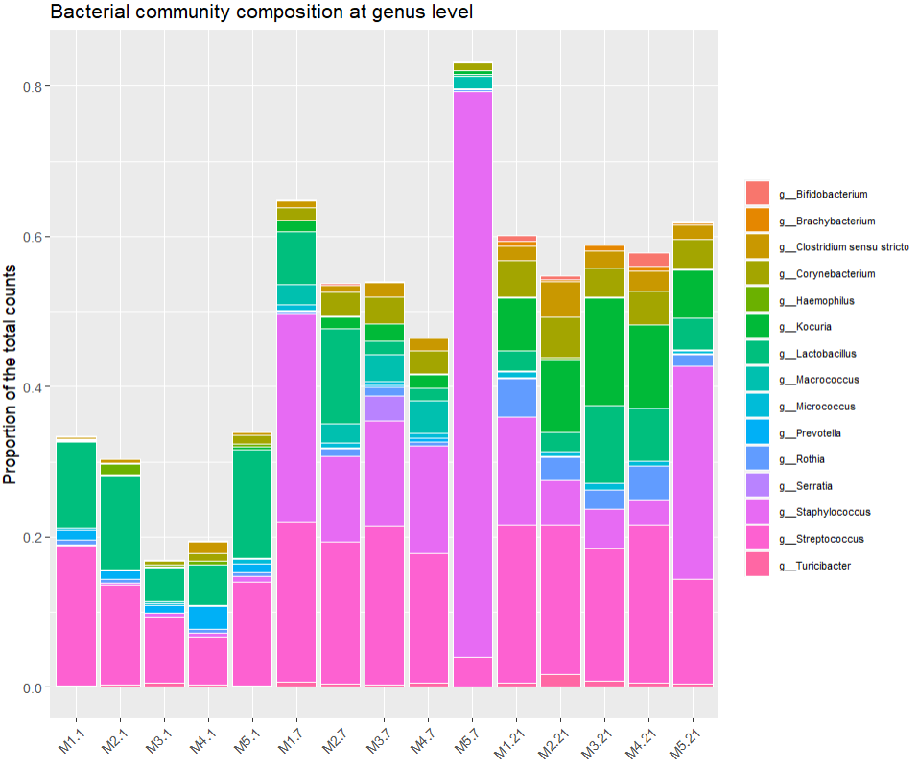
barplot

Slide 33
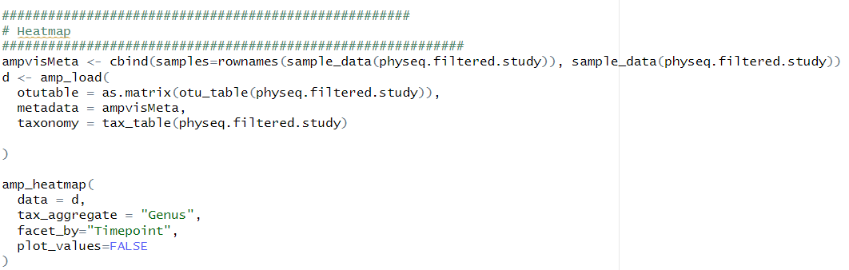
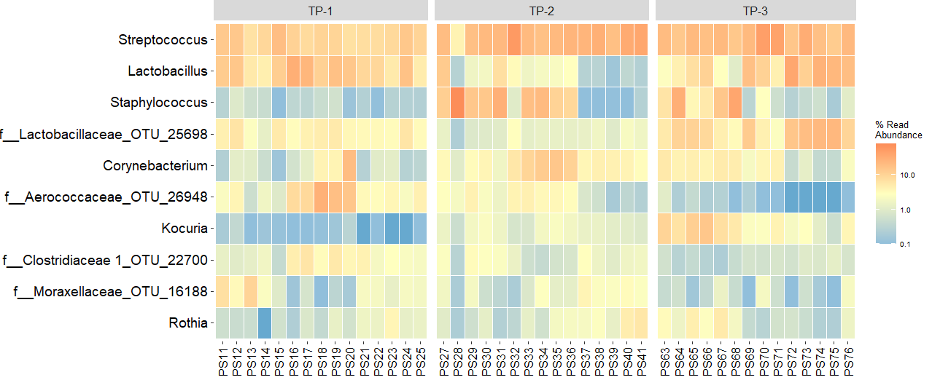
heatmap

Slide 34
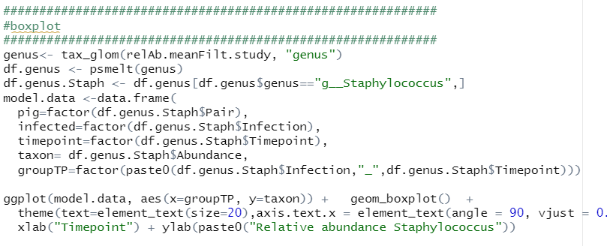
boxplot

Slide 35
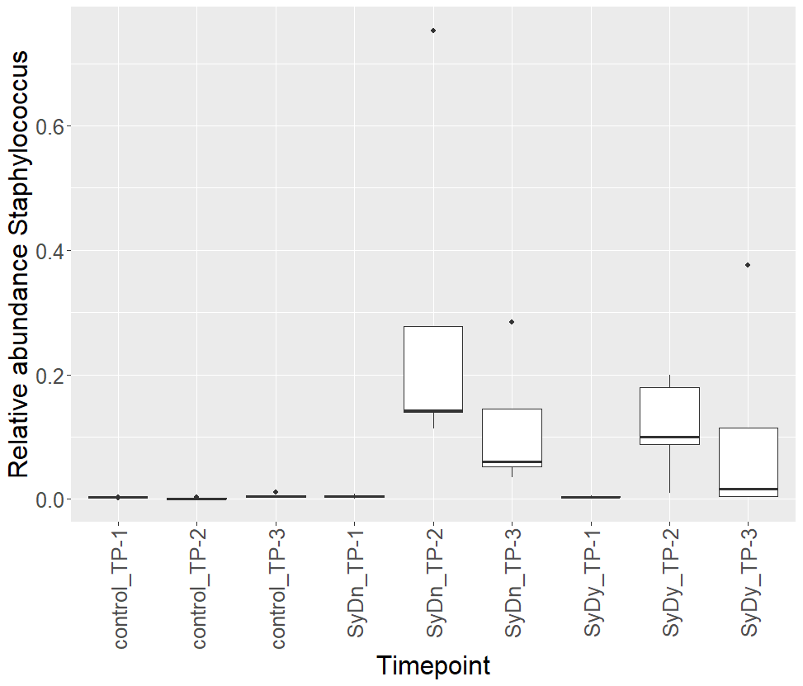
boxplot

Slide 36
Common univariate tests
Parametric tests
Assume normal distributions
t-test (2 groups)
ANOVA (three or more groups)
Non-parametric test
They typically consider only the ranks of values (order of values) not the actual values themselves
Wilcoxon Rank Sum test
Kruskal Wallis

Slide 37
Controlling for multiple tests
Alpha = 0.05 significance level
100 test on genus level: 5 genera will appear significant by chance
Type 1 error: Reject hypothesis that genus is similar but actually it should not be rejected
Bonferroni correction
Strict
Holm
Less conservative correction
Rank based
False discovery rate (FDR)
Commonly used in microbiobiology
Expected rate of false positives (0.2: 20% hits are false positive)

Slide 38
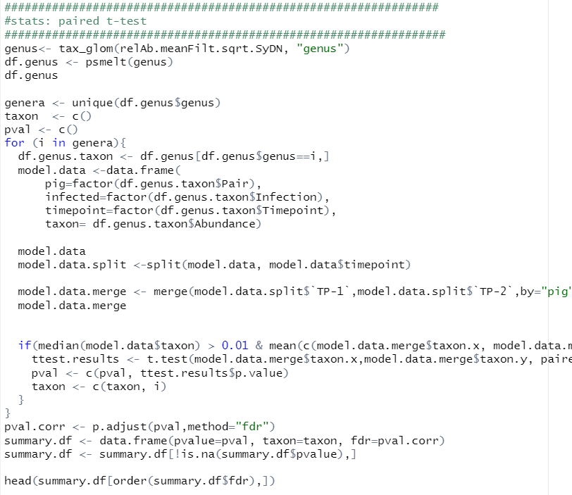
Paired t test

Slide 39
Mixed effect linear regression
Analysis of longitudinal data (time series; repeated measures)
outcome ~ fixed effect + random effect
outcome: predictor, dependent variable
Fixed effect are variables that may have effect on response variable (explanatory variables)
Random effects are random variables that may not be independent, and which are controlled (grouping factors)

Slide 40
Diversity
Data reduction measures for
Summarizing large number of observations
Visualizing many interconnected variables in compact a manner
Alpha diversity: Species richness within a sample (e.g. Shannon diversity)
Beta diversity: species composition across a collection of samples

Slide 41
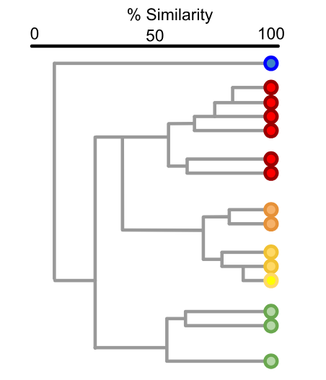
Hierarchical cluster analysis
Placing objects in groups, called clusters
Attempts to find a good grouping of objects based on a distance matrix in a hierarchical manner
Similarities between objects within these groups should be larger than those between groups

Slide 42
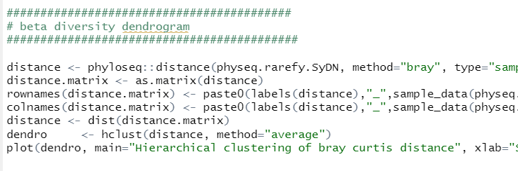
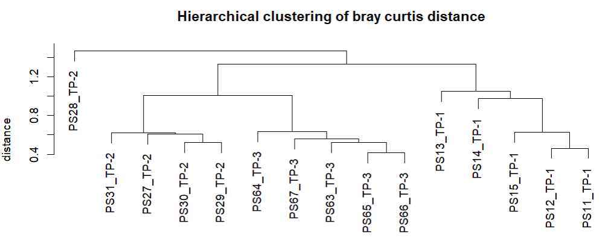
Beta diversity

Slide 43
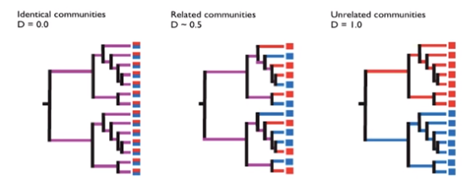
Metrics: uniFrac
A distance measure comparing multiple communities using phylogenetic information derived from alignment and phylogentic inference
Percent of observed branch length unique to either sample

Slide 44
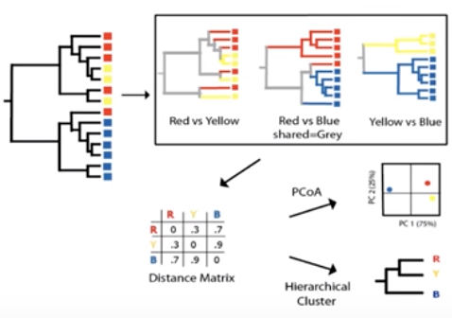
Metrics: uniFrac

Slide 45
Metrics
Ordination is essentially reducing dimensionality
First requirement: accurately model differences among samples
Models:
presence/absence: Jaccard
abundance: Bray-Curtis
Phylogenetic:UniFrac

Slide 46
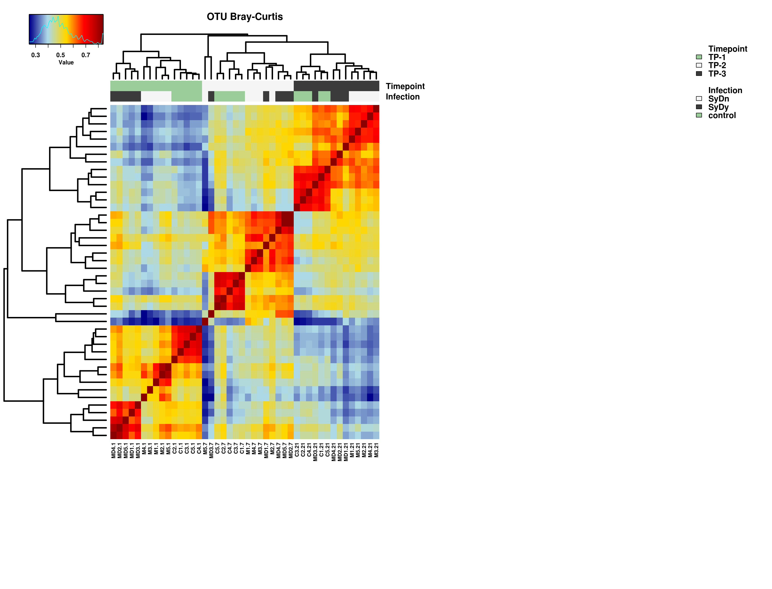
Hierarchical cluster analysis

Slide 47
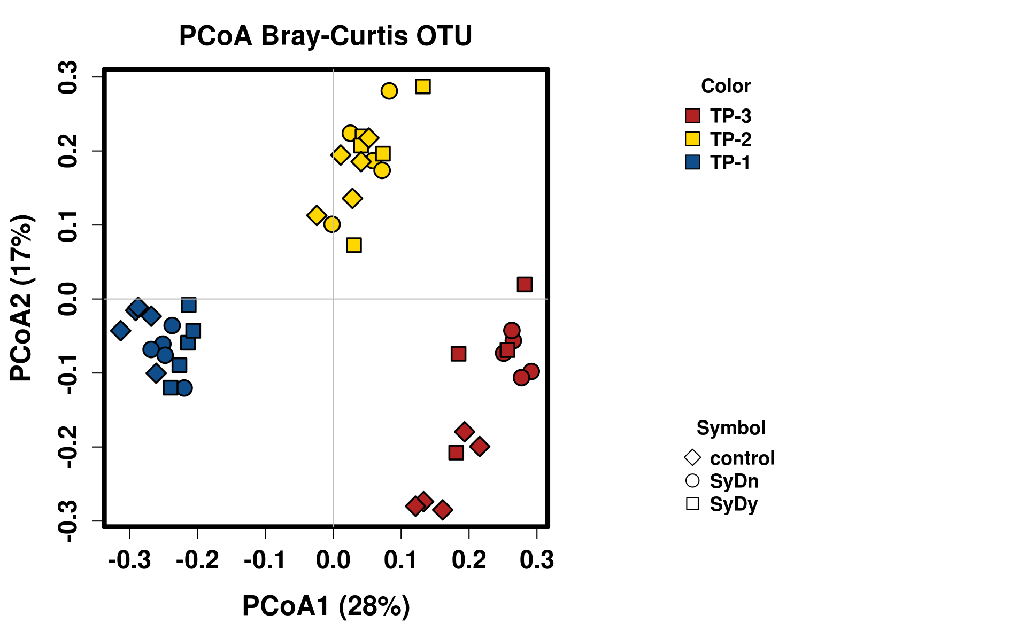
Principal Coordinates Analysis
Used for visualizing phylogenetic or count-based distances
Represents variance explained on axis (%)
Position of objects in low-dimensional space while preserving distance relationships as well as possible

Slide 48
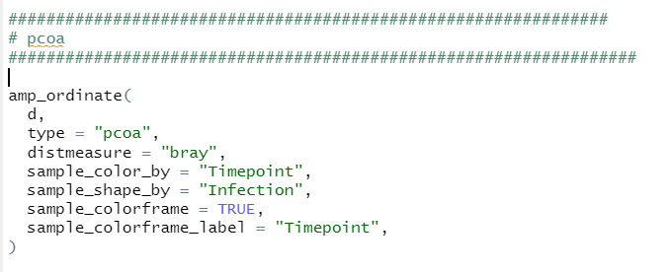
PCoA

Slide 49
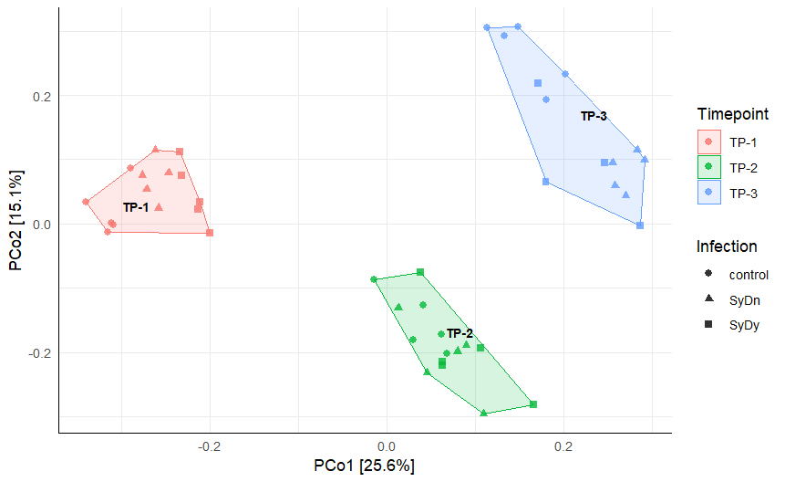
Principal Coordinates Analysis

Slide 50
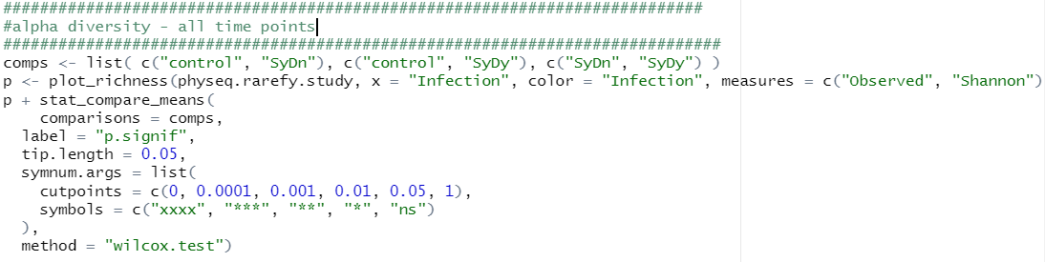
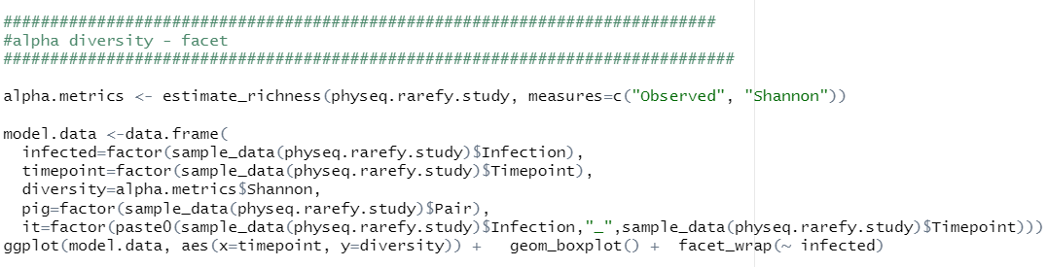
Alpha diversity

Slide 51
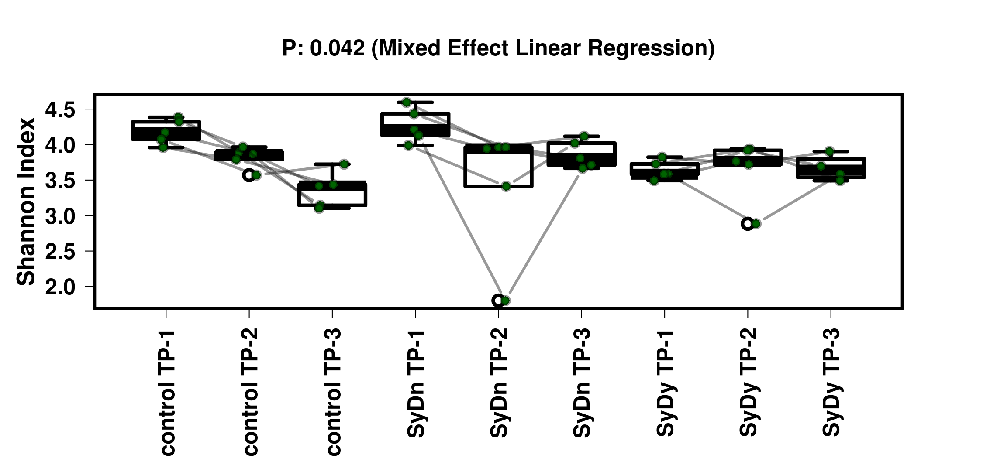
Shannon Diversity

Slide 52
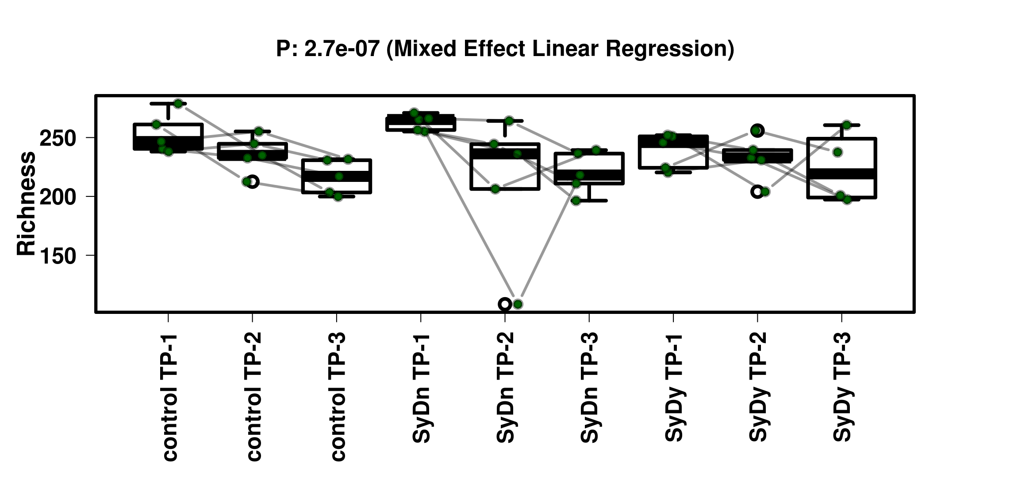
Diversity - richness

Slide 53
Summary
QIIME2 for the data processing of 16S rRNA gene data
Scabies infestation affects pig skin microbiota
Bacterial coinfection occurs with scabies infestation
Staphylococcus increased on week 7 and remained after treatment and healing
Combined treatment of antibiotics and scabies drugs necessary
Human study in progress

